Slide 1











BUILD YOUR OWN TRUCK
1920 SERIES
4x2 HAULAGE
1920 HG
1920 HM
1920 HN
1920 HU
Best-in-class | Superior Tyre | Higher Reliability & | Better Productivity & | Higher Safety | Cabin Options and | Overall TCO
fluid efficiency | Mileage | Low Maintenance Cost | Performance |  | Comfort features | advantage

Slide 2

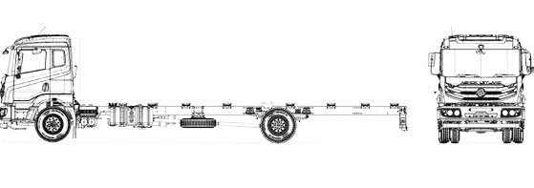

SPECIFICATIONS
Engine type Max power Max torque Clutch
Gear box Front axle Rear axle
Front suspension
MAJOR DIMENSIONS
H series BS-VI with i-Gen6 technology 147 kW @ 2400 rpm
700 Nm @ 1200 - 1900 rpm
380 mm dia - with air assisted hydraulic booster 6 speed synchromesh gear box
Forged I section – Reverse Elliot type Fully ﬂoating single speed rear axle Semi-elliptic multi leaf
Optional: Parabolic springs
Semi-elliptic multi leaf with parabolic helper springs HSS material with new improved design
Full air dual line brakes with ABS Cross linked polymer
Capacity: 375 L on LH side
For POL variants: 220 L on RH side Additional fuel tank on RH side
48 L
80 kmph (60 kmph for POL variants) 24 V - 120 Ah (150 Ah for AC Models) 295/90 R 20
G - Economy Cowl, M - Economy cabin, U - Value cabin and N - Premium cabin, AC option on U and N variants
Cowl & chassis / Cabin & chassis
FAW - 7,000 kg; RAW - 11,500 kg; GVW - 18,500 kg
Loading span | 5.6 m | 6.2 m | 6.8 m | 7.4 m | 8.1 m | 8.7 m | 9.3 m | 9.7 m
Wheelbase | 4350 mm | 4750 mm | 5050 mm | 5600 mm | 6100 mm | 6350 mm | 6600 mm | 6600 mm
Overall length | 7910 mm | 8510 mm | 9110 mm | 9710 mm | 10360 mm | 10960 mm | 11560 mm | 11960 mm
Turning circle dia | 15.7 m | 17.2 m | 18.2 m | 20.2 m | 22 m | 22.9 m | 23.8 m | 23.8 m
Overall width | 2570 mm
Overall height | M - 2987 mm / U - 3247 mm / N(WIM) - 3177 mm
Rear suspension Chassis frame Brakes
Fuel tank
SCHEMATIC LAYOUT
DEF tank Max speed Electricals Tyres Cabin
APPLICATIONS
Specifications & images are indicative and subject to change. Jan’23
Market load
POL
tanker
FMCG
Parcel &
e Commerce
Two Wheeler
Carrier
White goods
Vehicle conﬁguration options
Chassis weight (Laden)
AUTHORISED DEALER
Registered Office - Ashok Leyland Limited, No. 1, Sardar Patel Road, Guindy, Chennai - 600032, Tel. - 91 44 2220 6000
E-mail - reachus@ashokleyland.com | Website - www.ashokleyland.com

